Slide 1

Malawi Compost Transporter ​
Midpoint Presentation​
Husain Aldawood​
Connor Schmerfeld​
Hope Williams​
Shi Zhang​
​

Slide 2
Project Description
Our Project | Customer Requirements
Building a machine that is capable of transporting compost from one place to another in a small village in Malawi. Client: Dr. McDonnell. | Maneuverable Size Safe to operate Durable design Operable off-roading Easy to Operate Maintainable Manufacturable Cost-efficient Reliable large Capacity Rechargeable Environment Friendly
Engineering Requirement
Compact Size with lightweight
High Capacity Battery
Cost-Efficient

Slide 3
Design Description
Removable Wall, Hinges
Hydraulic Jack
DC Motor
Carriage to Hold Parts
Lithium Batteries
15" Gorilla Cart Tires
Compact Size (4ft long x 3ft Wide)
Steering Mechanism

Slide 4
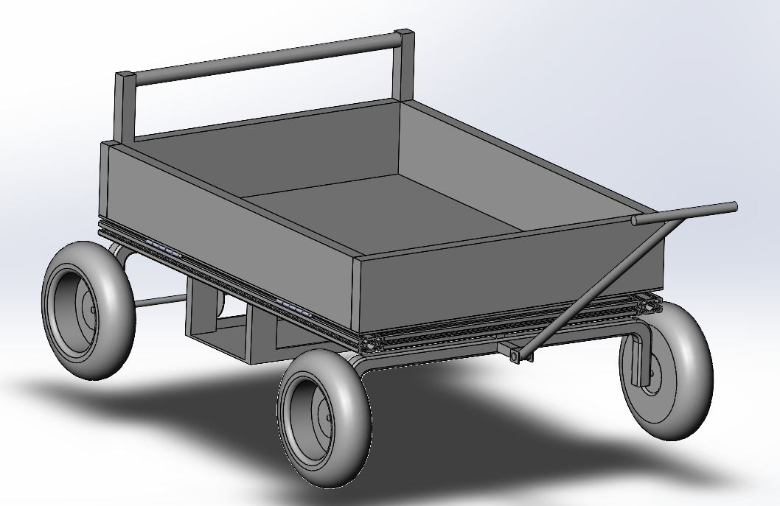
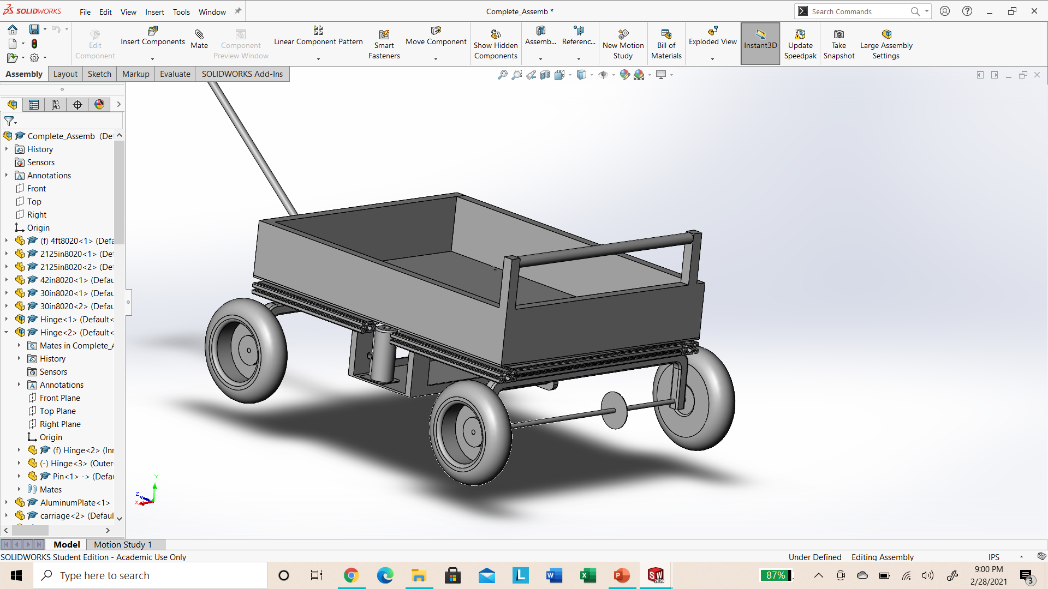
CAD Model

Slide 5
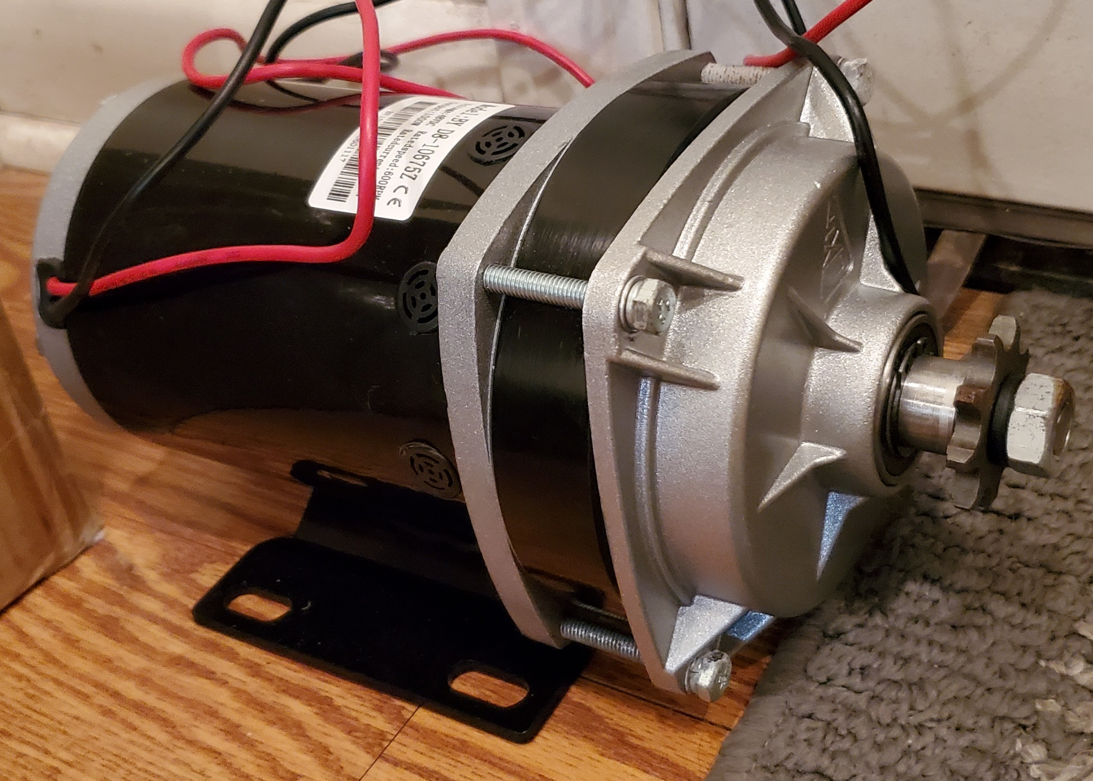
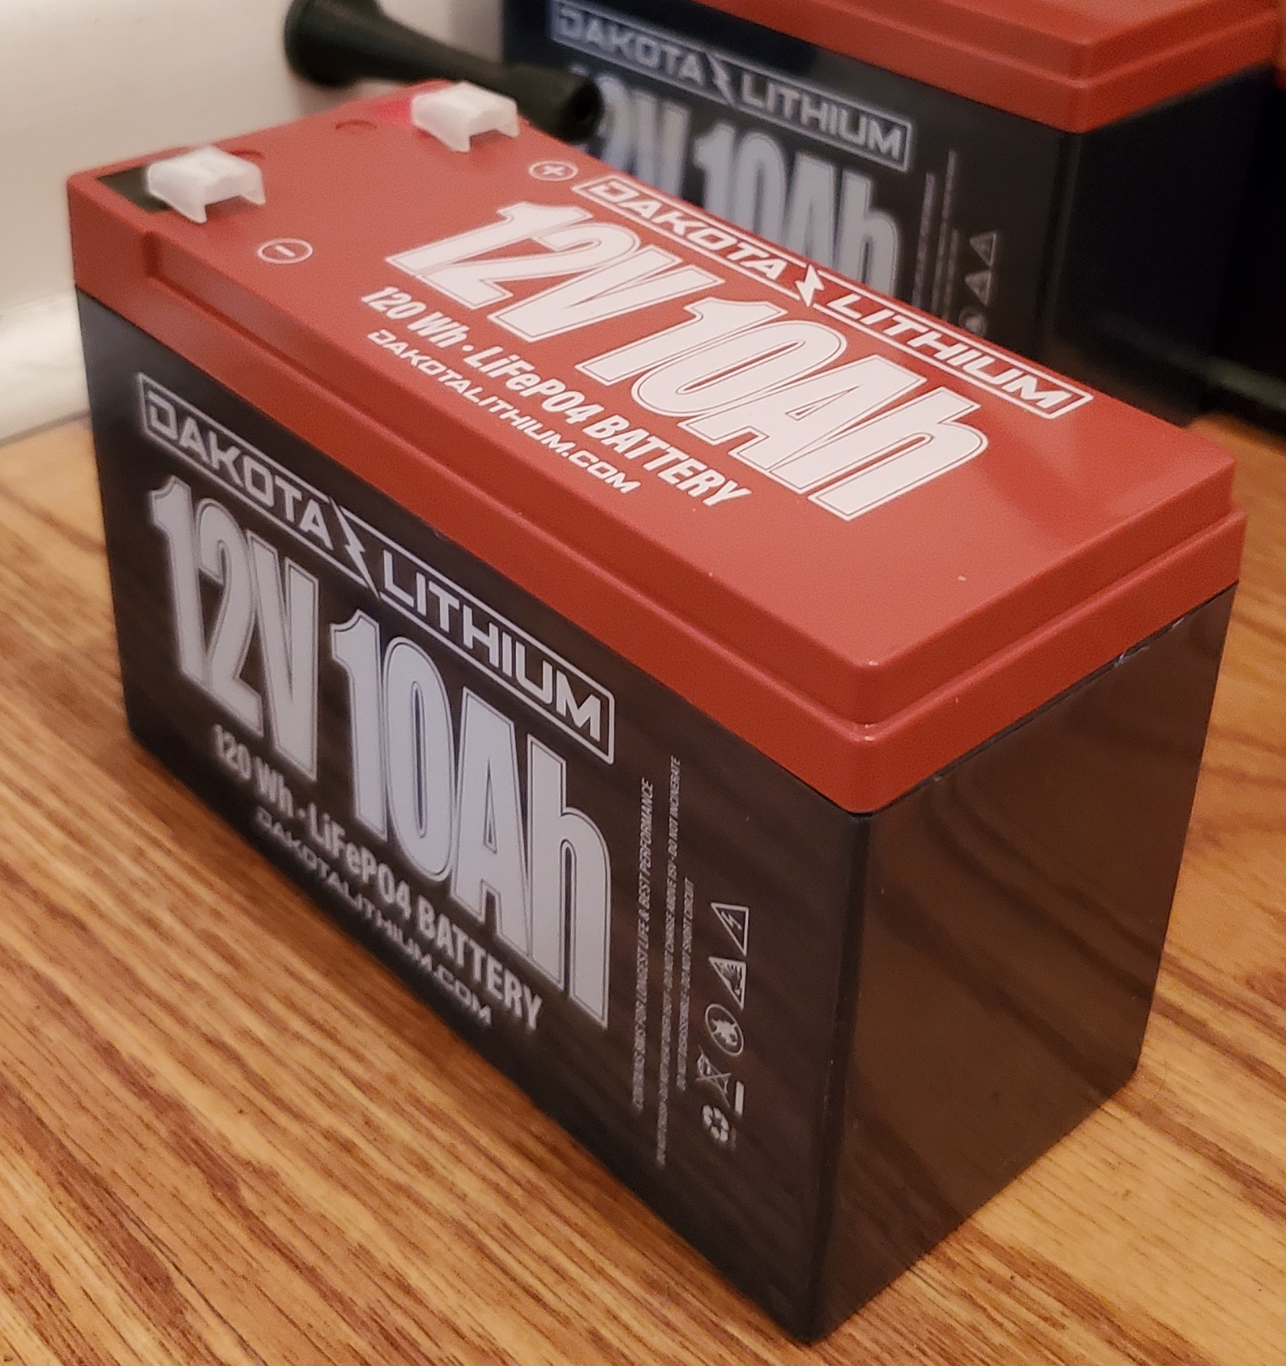
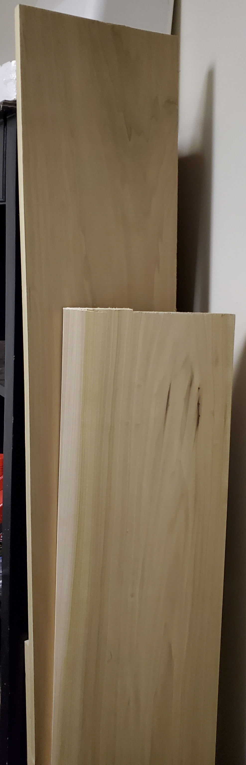
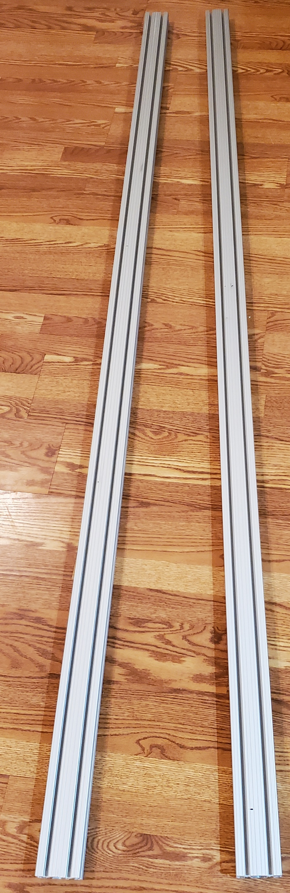
Current State of the System

Slide 6
Engineering Requirements
ERs that have been met | ERs that still need to be met
Increase Battery Life | Decrease Weight
Increase Power | Decrease Manufacturing Cost
Increase Waste Capacity
Small Dimensions

Slide 7

Tasks Completed by Members for the Current State of the System
Hope: Picked the Motor and Designed the Basket
  DC motor and Basket for the motor and batteries under the device
Connor: Designed the Base of the Cart using 80/20 Aluminum and the CAD model
  Designed the CAD model and dimensioned the base of the cart
Husain: Picked out the best Tires for the cart
  Researched tires and found foam-filled will be the best for our clients' needs
Shi: Researched and found a Jack for the cart
  Researched jacks and which way we should dump the cart

Slide 8
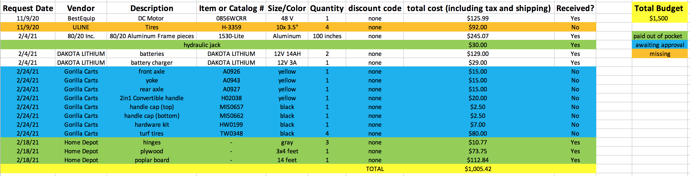
Bill of Materials
Figure 1: Bill of Materials

Slide 9
Implementation Plan
Manufacturing and Designing Plan:
  All items will be shipped or brought to Connor's House
  His garage will be our main place of manufacturing and designing the cart
Future Work

Slide 10
Testing Plan
The team will test the cart by seeing how the device runs with various loads applied. The team, when ready, will test up to 500 pounds as that is the maximum load the client wants.
  Test with:
    No load
    100 pounds
    200 pounds
    300 pounds
    400 pounds
    500 pounds

Slide 11


